Slide 1
When easy is not preferred: A discounting paradigm to assess load-independent task preference
Josephine Zerna
Differential and Personality Psychology, TU Dresden
Registered Report
Zerna, J.*, Scheffel, C.*, Kührt, C., & Strobel, A.
Pre-Data Talk, DGPs Congress Hildesheim 2022

Slide 2
Outline
Motivation: Effort findings and the COG-ED Paradigm
The CAD Paradigm: Taking objective load out of the equation
Analyses & Specification Curve Analysis
Questions & Discussion

Slide 3
I. Motivation
Subjective effort is more important than effectiveness when deciding between emotion regulation strategies (Scheffel et al., 2021)
But: We still know very little about how choice options are valued
→ Cognitive Effort Discounting Paradigm (COG-ED) by Westbrook et al. 2013

Slide 4
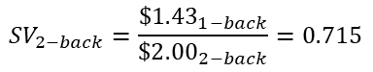
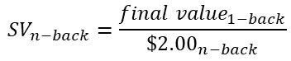
I. Motivation – The COG-ED Paradigm by Westbrook et al. 2013
Five pairings:
1-back vs. 2-back
1-back vs. 3-back
1-back vs. 4-back
1-back vs. 5-back
1-back vs. 6-back
Subjective values:
$${SV}_{n−back}=\frac{{final value}_{1−back}}{{\$2.00}_{n−back}}$$
$${SV}_{2−back}=\frac{{\$1.43}_{1−back}}{{\$2.00}_{2−back}}=0.715$$

Slide 5
I. Motivation – The COG-ED Paradigm by Westbrook et al. 2013
SV_{n} = the minimum relative reward required for me to choose 1-back over n-back, thereby forgoing the higher reward for n-back
Subjective values:
$${SV}_{n−back}=\frac{{final value}_{1−back}}{{\$2.00}_{n−back}}$$
But what if someone does not prefer the easiest level?
$${SV}_{2−back}=\frac{{\$1.43}_{1−back}}{{\$2.00}_{2−back}}=0.715$$

Slide 6
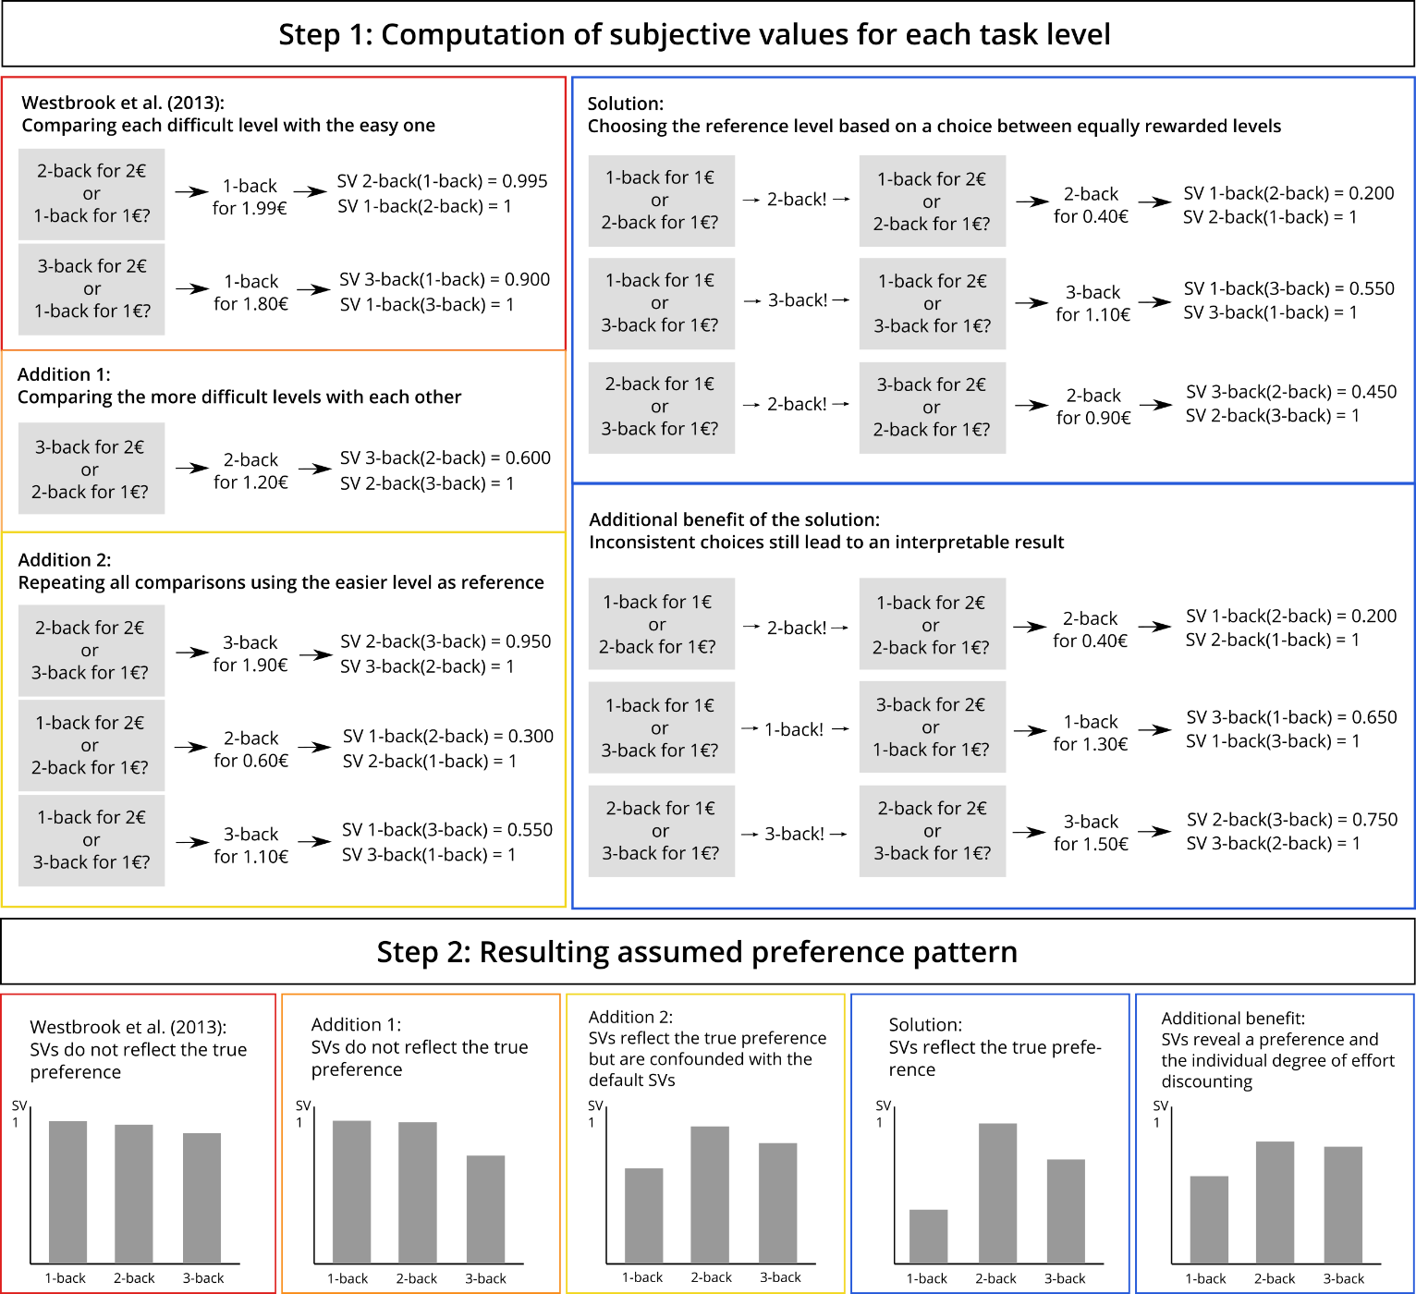
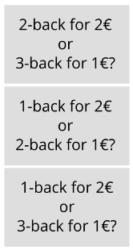
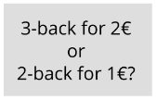
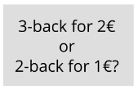
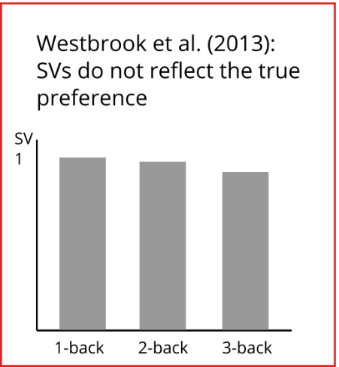
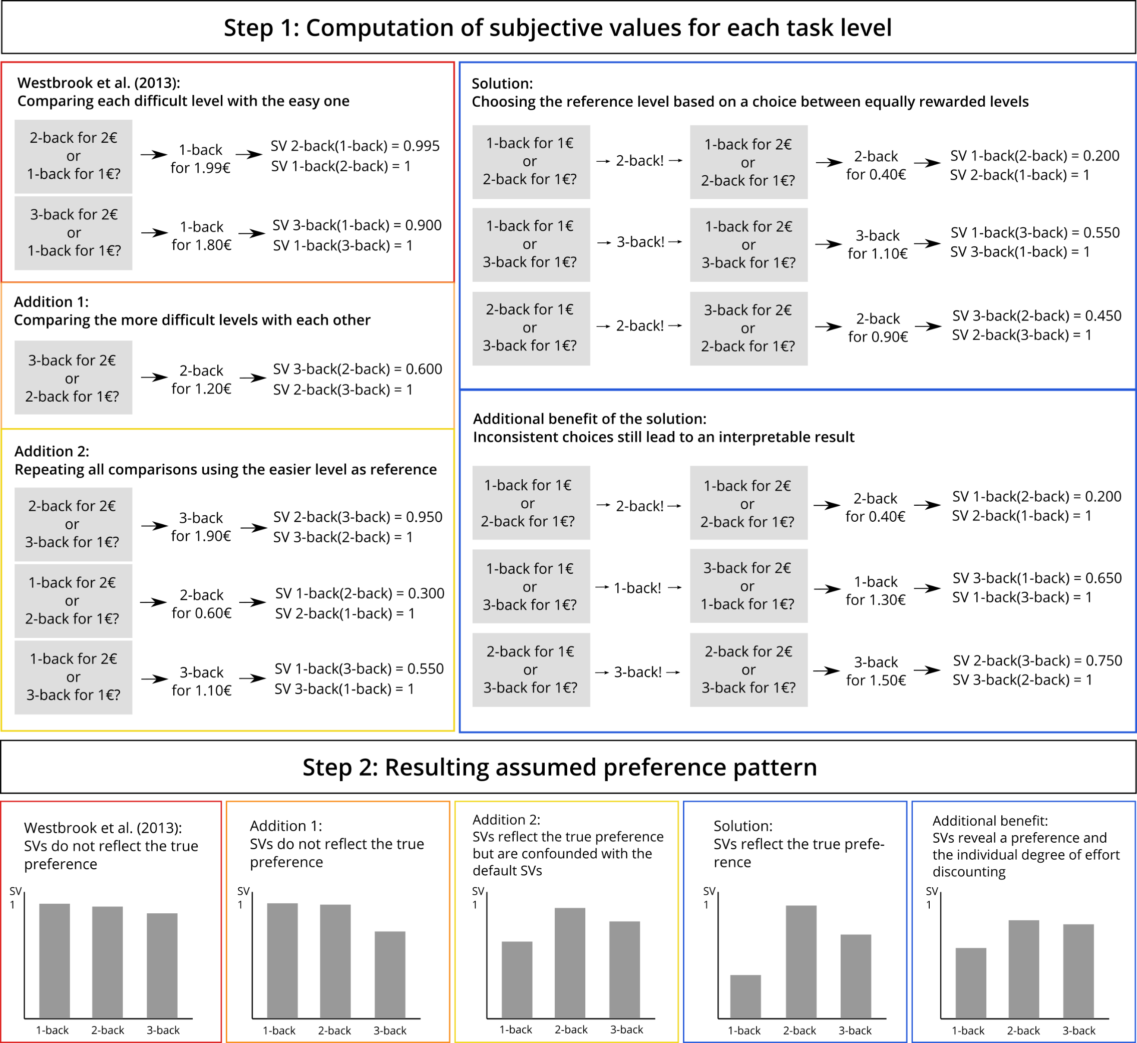
II. The Cognitive Affective Discounting (CAD) Paradigm
Hypothetical subjective values of a participant with the preference 2-back > 3-back >1-back

Slide 7
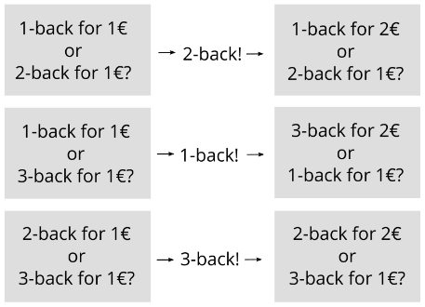
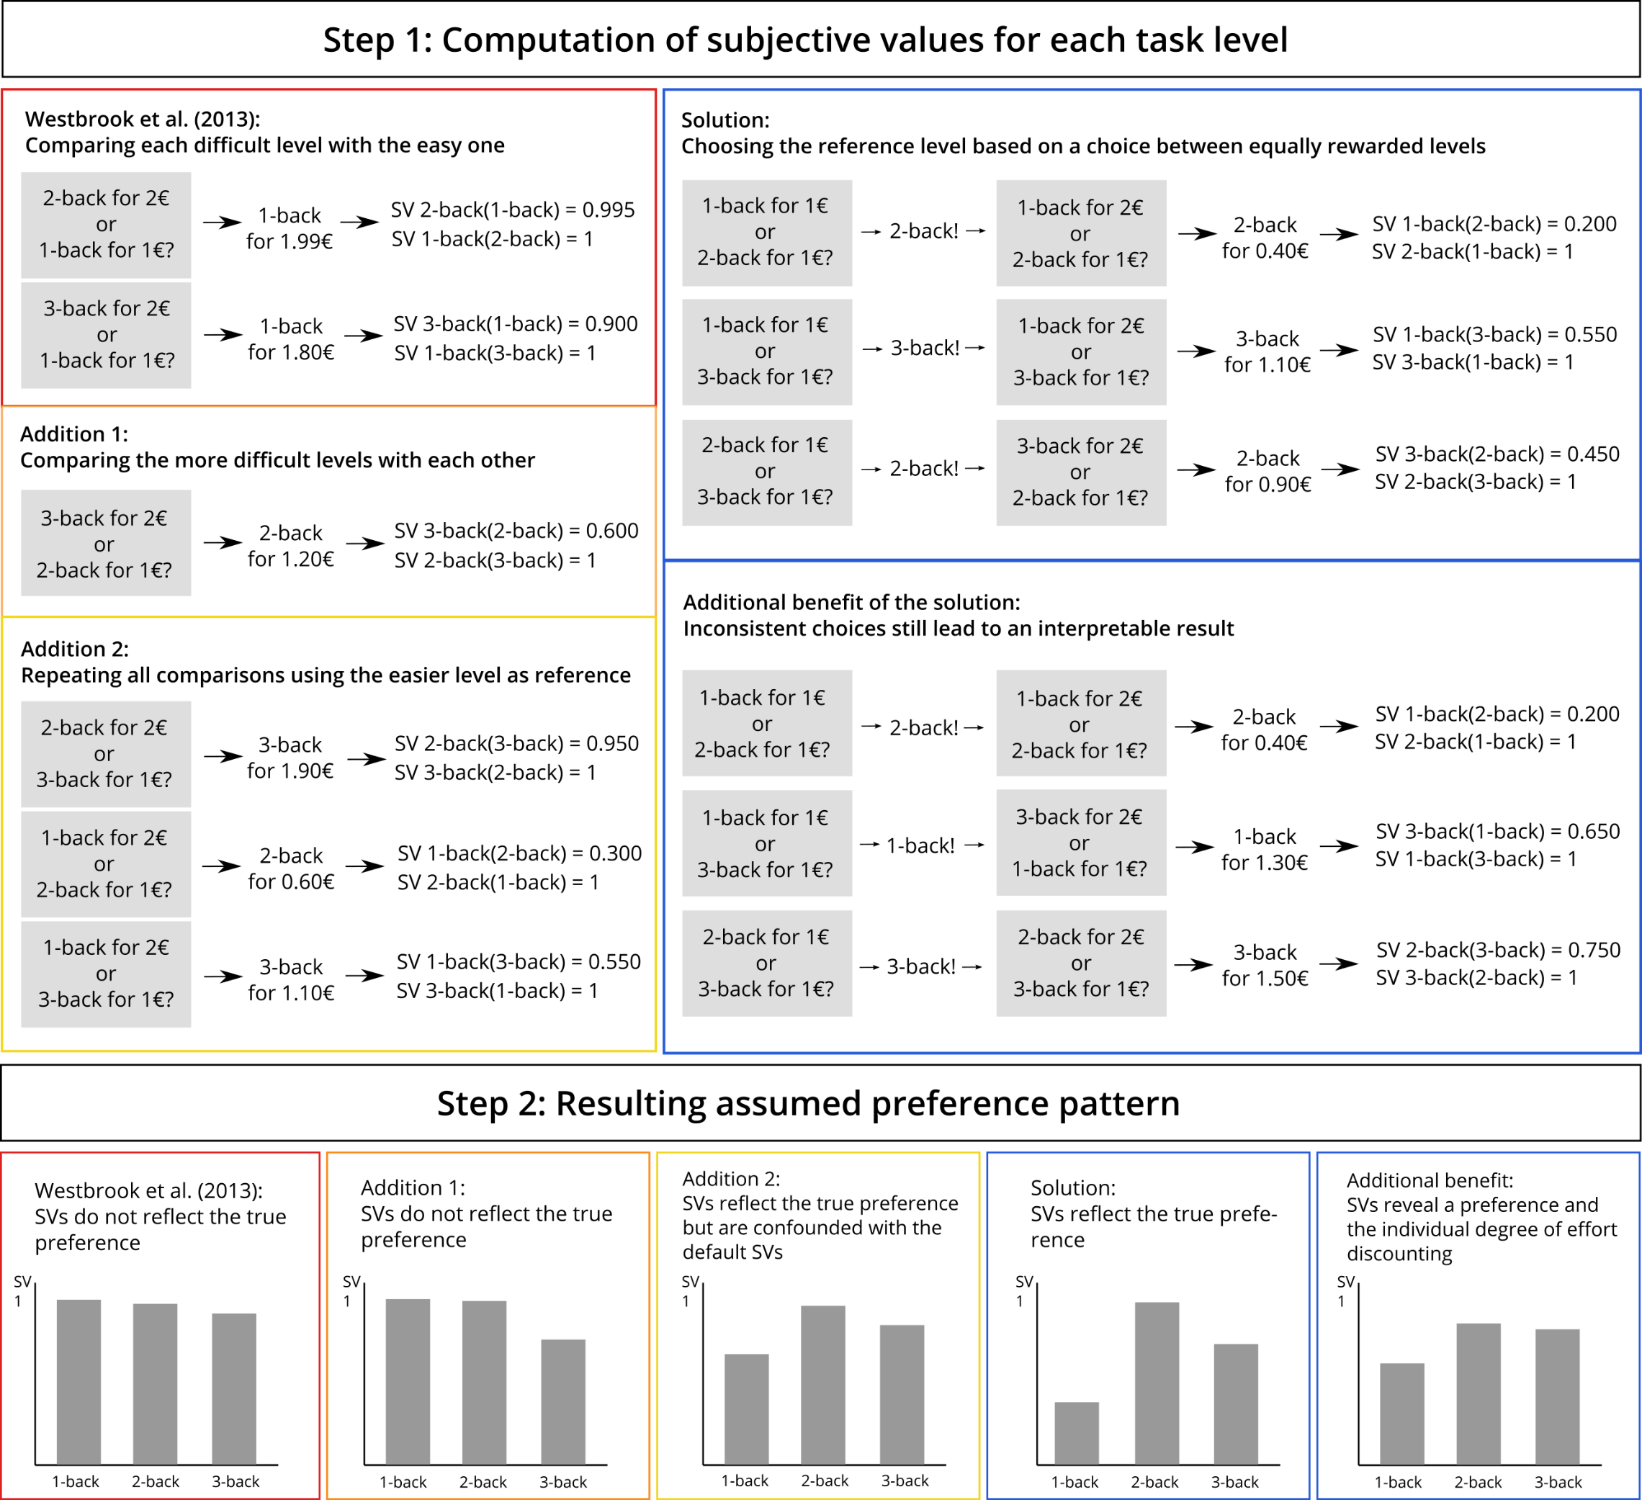
II. The Cognitive Affective Discounting (CAD) Paradigm
Hypothetical subjective values of a participant with the preference 2-back > 3-back >1-back
In case of inconsistent choices

Slide 8
III. Analyses and Specification Curve Analysis
Study Design:
Personality questionnaires (online)
Need for Cognition
Self-Control
Emotion Regulation
…
Lab session 1
n-back Task with n = 1 to n = 4
CAD Paradigm
One randomly chosen n-back level
Lab session 2 (one week later)
Emotion regulation strategy training
Emotion regulation paradigm
CAD Paradigm
Emotion regulation choice

Slide 9
References
Scheffel, C., Graupner, S.-T., Gärtner, A., Zerna, J., Strobel, A., & Dörfel, D. (2021). Effort beats effectiveness in emotion regulation choice: Differences between suppression and distancing in subjective and physiological measures. Psychophysiology, 58, e13908. https://doi.org/10.1111/psyp.13908
Westbrook A, Kester D, Braver TS (2013) What Is the Subjective Cost of Cognitive Effort? Load, Trait, and Aging Effects Revealed by Economic Preference. PLoS ONE 8(7): e68210. https://doi.org/10.1371/journal.pone.0068210

